Slide 1
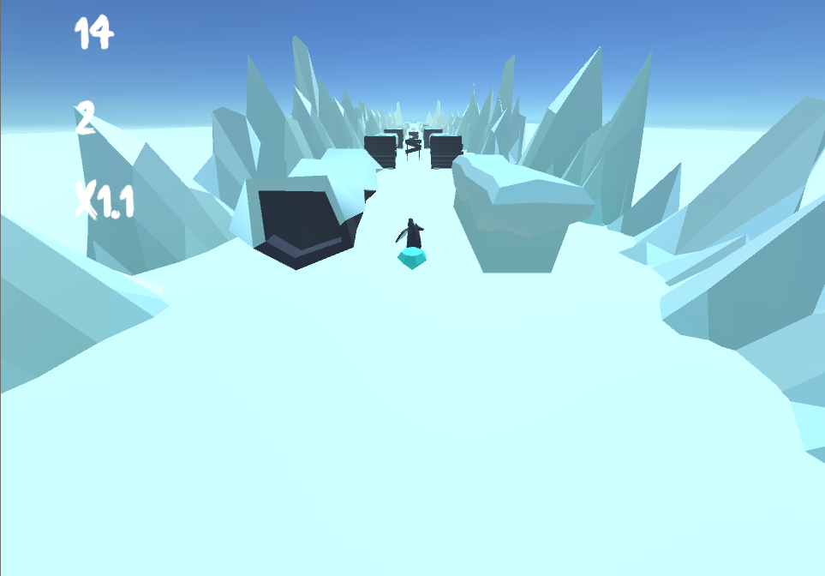

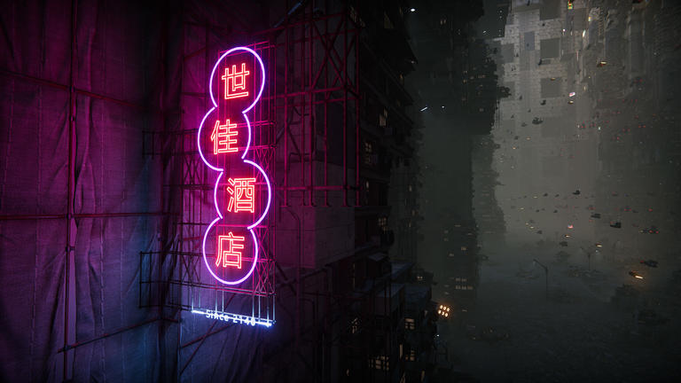
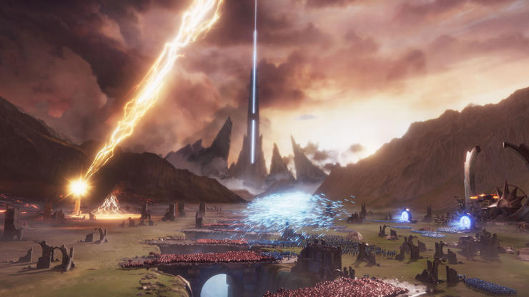
Procedural Generation in Penguin Run
(Unity Game Engine)

Slide 2
What Was The Task?
Situation
The task was to create a mobile game in 3 months
I brainstormed a few ideas with some fellow students and came up with an endless runner concept. E.g Temple Run
In this game we used procedural generation to create the obstacles dynamically

Slide 3
What Is Procedural Generation?
Procedural Generation is a method of creating levels algorithmically using premade assets coupled with computer-generated randomness.
Instead of a level being premade by the developer, we use an algorithm to generate multiple sections of randomised obstacles
We determined that we could engage the user for longer because the level would always present a different challenge every time it is played.

Slide 4
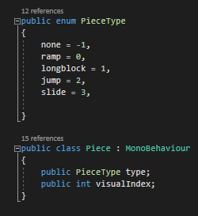
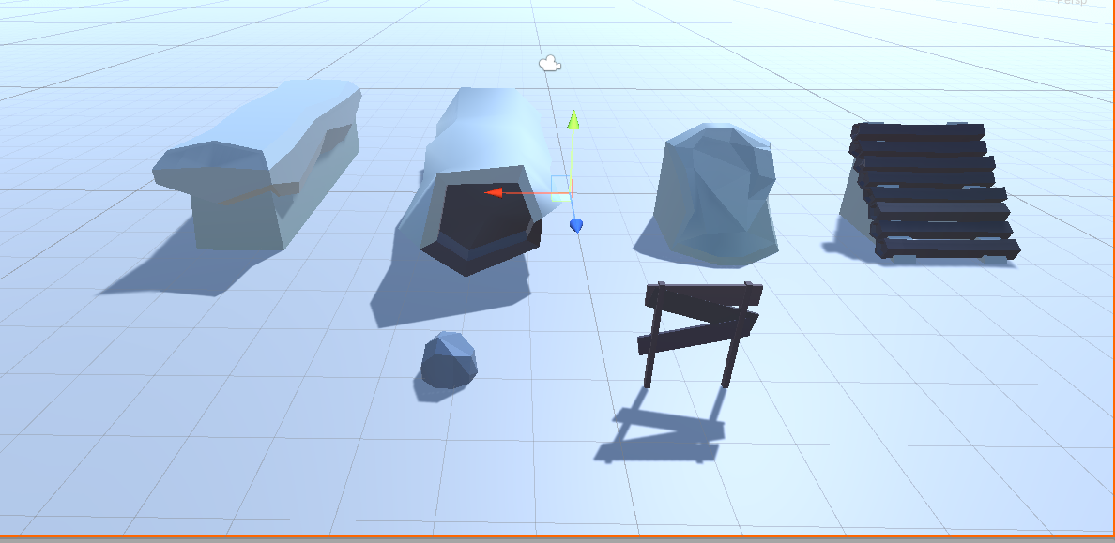
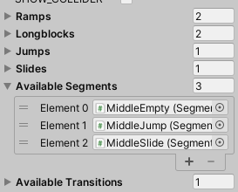
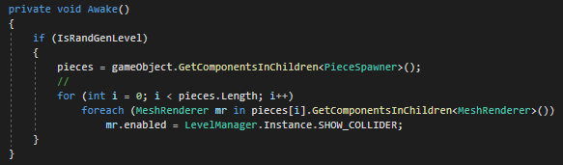
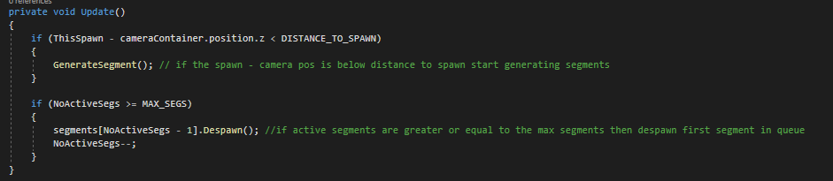
Generating the obstacles
After extensive research I used a pooling system to generate the obstacles.
Every piece has piece type and visual index
I created segments consisting of different types of obstacles which I then put into a pooling system.
The algorithm would then loop through each segment and randomise them as the game was played.
These obstacles would then delete after the max segments had been reached to ensure performance was not impacted

Slide 5
Conclusion and Questions
Achievement
Released on Google Play
Had over 1000 downloads
Are there any questions?

Slide 6
References.
Jarek Francik:
https://www.youtube.com/watch?time_continue=1770&v=ubwv2uBZ1w8&feature=emb_title
GameAcadamy.School:
https://www.youtube.com/watch?v=E8VNVTsRE4I
Unity:
https://docs.unity3d.com/Packages/com.unity.entities@0.1/manual/ecs_systems.html
https://learn.unity.com/tutorial/entity-component-system#
Code Monkey:
https://www.youtube.com/watch?v=ILfUuBLfzGI&list=PLzDRvYVwl53s40yP5RQXitbT--IRcHqba
https://www.youtube.com/watch?v=C56bbgtPr_w&list=PLzDRvYVwl53s40yP5RQXitbT--IRcHqba&index=2
Further Research
MegaCity & SpellSouls RTS:
https://www.youtube.com/watch?v=j4rWfPyf-hk&feature=emb_rel_pause
https://www.youtube.com/watch?v=GEuT5-oCu_I

